Slide 1
Sorting
Write the CODE yourself. This slide contains only theory.

Slide 2
Sorting
Sorting algorithm is an algorithm that puts elements of a list in a certain order. The most-used orders are numerical order and lexicographical order.
It can be implemented via many different algorithms.
Following is the list of sorting algorithms which will be explained in this presentation:
Insertion Sort, Selection Sort, Bubble Sort.

Slide 3
Insertion Sort
while some elements unsorted:
Using linear search, find the location in the sorted portion where the 1st element of the unsorted portion should be inserted
Move all the elements after the insertion location up one position to make space for the new element
45
38
60
45
66
60
45
66
79
47
13
74
36
21
94
22
57
16
29
81
the fourth iteration of this loop is shown here

Slide 4
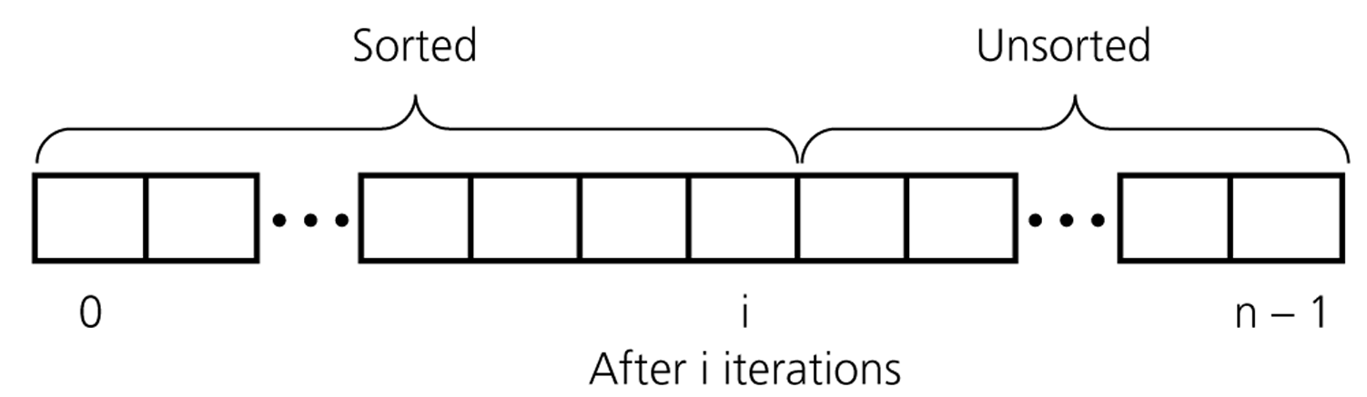
An insertion sort partitions the array into two regions

Slide 5
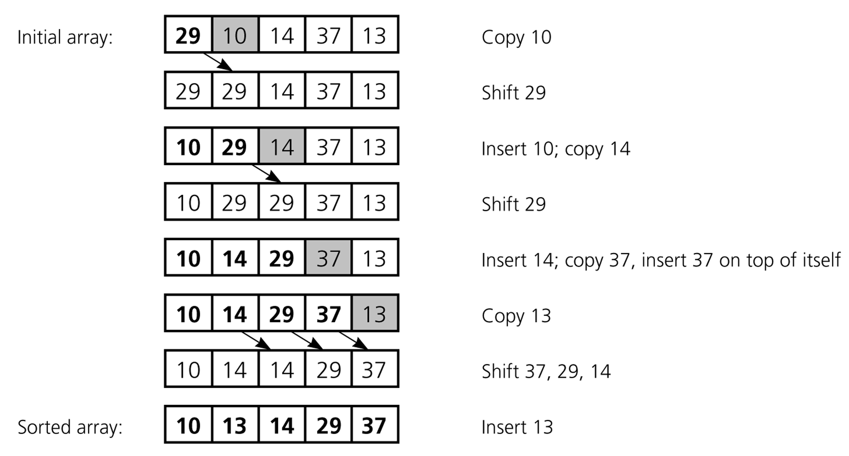
An insertion sort of an array of five integers

Slide 6
Insertion Sort Algorithm
public void insertionSort(Comparable[] arr) {
for (int i = 1; i < arr.length; ++i) {
Comparable temp = arr[i];
int pos = i;
// Shuffle up all sorted items > arr[i]
while (pos > 0 &&
arr[pos-1].compareTo(temp) > 0) {
arr[pos] = arr[pos–1];
pos--;
} // end while
// Insert the current item
arr[pos] = temp;
}
}

Slide 7
Insertion Sort Analysis
public void insertionSort(Comparable[] arr) {
for (int i = 1; i < arr.length; ++i) {
Comparable temp = arr[i];
int pos = i;
// Shuffle up all sorted items > arr[i]
while (pos > 0 &&
arr[pos-1].compareTo(temp) > 0) {
arr[pos] = arr[pos–1];
pos--;
} // end while
// Insert the current item
arr[pos] = temp;
}
}
outer loop
outer times
inner loop
inner times

Slide 8
Insertion Sort: Number of Comparisons
# of Sorted Elements | Best case | Worst case
0 | 0 | 0
1 | 1 | 1
2 | 1 | 2
… | … | …
n-1 | 1 | n-1
 | n-1 | n(n-1)/2
Remark: we only count comparisons of elements in the array.

Slide 9
Insertion Sort: Cost Function
1 operation to initialize the outer loop
The outer loop is evaluated n-1 times
5 instructions (including outer loop comparison and increment)
Total cost of the outer loop: 5(n-1)
How many times the inner loop is evaluated is affected by the state of the array to be sorted
Best case: the array is already completely sorted so no “shifting” of array elements is required.
We only test the condition of the inner loop once (2 operations = 1 comparison + 1 element comparison), and the body is never executed
Requires 2(n-1) operations.

Slide 10
Insertion Sort: Cost Function
Worst case: the array is sorted in reverse order (so each item has to be moved to the front of the array)
In the i-th iteration of the outer loop, the inner loop will perform 4i+1 operations
Therefore, the total cost of the inner loop will be 2n(n-1)+n-1
Time cost:
Best case: 7(n-1)
Worst case: 5(n-1)+2n(n-1)+n-1
What about the number of moves?
Best case: 2(n-1) moves
Worst case: 2(n-1)+n(n-1)/2

Slide 11
Insertion Sort: Average Case
Is it closer to the best case (n comparisons)?
The worst case (n * (n-1) / 2) comparisons?
It turns out that when random data is sorted, insertion sort is usually closer to the worst case
Around n * (n-1) / 4 comparisons
Calculating the average number of comparisons more exactly would require us to state assumptions about what the “average” input data set looked like
This would, for example, necessitate discussion of how items were distributed over the array
Exact calculation of the number of operations required to perform even simple algorithms can be challenging (for instance, assume that each initial order of elements has the same probability to occur)

Slide 12
SELECTION SORT
Idea:
Find the smallest element in the array
Exchange it with the element in the first position
Find the second smallest element and exchange it with the element in the second position
Continue until the array is sorted
Disadvantage:
Running time depends only slightly on the amount of order in the file

Slide 13
Selection Sort
5 | 1 | 3 | 4 | 6 | 2
Comparison
Data Movement
Sorted

Slide 14
Selection Sort
5 | 1 | 3 | 4 | 6 | 2
Comparison
Data Movement
Sorted

Slide 15
Selection Sort
5 | 1 | 3 | 4 | 6 | 2
Comparison
Data Movement
Sorted

Slide 16
Selection Sort
5 | 1 | 3 | 4 | 6 | 2
Comparison
Data Movement
Sorted

Slide 17
Selection Sort
5 | 1 | 3 | 4 | 6 | 2
Comparison
Data Movement
Sorted

Slide 18
Selection Sort
5 | 1 | 3 | 4 | 6 | 2
Comparison
Data Movement
Sorted

Slide 19
Selection Sort
5 | 1 | 3 | 4 | 6 | 2
Comparison
Data Movement
Sorted

Slide 20
Selection Sort
5 | 1 | 3 | 4 | 6 | 2
•
Largest
Comparison
Data Movement
Sorted

Slide 21
Selection Sort
5 | 1 | 3 | 4 | 2 | 6
Comparison
Data Movement
Sorted

Slide 22
Selection Sort
5 | 1 | 3 | 4 | 2 | 6
Comparison
Data Movement
Sorted

Slide 23
Selection Sort
5 | 1 | 3 | 4 | 2 | 6
Comparison
Data Movement
Sorted

Slide 24
Selection Sort
5 | 1 | 3 | 4 | 2 | 6
Comparison
Data Movement
Sorted

Slide 25
Selection Sort
5 | 1 | 3 | 4 | 2 | 6
Comparison
Data Movement
Sorted

Slide 26
Selection Sort
5 | 1 | 3 | 4 | 2 | 6
Comparison
Data Movement
Sorted

Slide 27
Selection Sort
5 | 1 | 3 | 4 | 2 | 6
Comparison
Data Movement
Sorted

Slide 28
Selection Sort
5 | 1 | 3 | 4 | 2 | 6
•
Largest
Comparison
Data Movement
Sorted

Slide 29
Selection Sort
2 | 1 | 3 | 4 | 5 | 6
Comparison
Data Movement
Sorted

Slide 30
Selection Sort
2 | 1 | 3 | 4 | 5 | 6
Comparison
Data Movement
Sorted

Slide 31
Selection Sort
2 | 1 | 3 | 4 | 5 | 6
Comparison
Data Movement
Sorted

Slide 32
Selection Sort
2 | 1 | 3 | 4 | 5 | 6
Comparison
Data Movement
Sorted

Slide 33
Selection Sort
2 | 1 | 3 | 4 | 5 | 6
Comparison
Data Movement
Sorted

Slide 34
Selection Sort
2 | 1 | 3 | 4 | 5 | 6
Comparison
Data Movement
Sorted

Slide 35
Selection Sort
2 | 1 | 3 | 4 | 5 | 6
•
Largest
Comparison
Data Movement
Sorted

Slide 36
Selection Sort
2 | 1 | 3 | 4 | 5 | 6
Comparison
Data Movement
Sorted

Slide 37
Selection Sort
2 | 1 | 3 | 4 | 5 | 6
Comparison
Data Movement
Sorted

Slide 38
Selection Sort
2 | 1 | 3 | 4 | 5 | 6
Comparison
Data Movement
Sorted

Slide 39
Selection Sort
2 | 1 | 3 | 4 | 5 | 6
Comparison
Data Movement
Sorted

Slide 40
Selection Sort
2 | 1 | 3 | 4 | 5 | 6
Comparison
Data Movement
Sorted

Slide 41
Selection Sort
2 | 1 | 3 | 4 | 5 | 6
•
Largest
Comparison
Data Movement
Sorted

Slide 42
Selection Sort
2 | 1 | 3 | 4 | 5 | 6
Comparison
Data Movement
Sorted

Slide 43
Selection Sort
2 | 1 | 3 | 4 | 5 | 6
Comparison
Data Movement
Sorted

Slide 44
Selection Sort
2 | 1 | 3 | 4 | 5 | 6
Comparison
Data Movement
Sorted

Slide 45
Selection Sort
2 | 1 | 3 | 4 | 5 | 6
Comparison
Data Movement
Sorted

Slide 46
Selection Sort
2 | 1 | 3 | 4 | 5 | 6
•
Largest
Comparison
Data Movement
Sorted

Slide 47
Selection Sort
1 | 2 | 3 | 4 | 5 | 6
Comparison
Data Movement
Sorted

Slide 48
Selection Sort
1 | 2 | 3 | 4 | 5 | 6
DONE!
Comparison
Data Movement
Sorted

Slide 49
Backup Slides

Slide 50
void selection_sort(int n, int list[])
{
int min, temp;
int k, l, index;
for(index = 0; index< n - 1 ; index++)
{ min = index ;
for(k = index + 1; k < n ; k ++)
{ if(list[min] > list[k])
min = k ;
}
if(min != index)
{ temp = `list [index];
list[index] = list[min];
list[min] = temp;
} printf(" \n Step : %d :",(index+1));
for( l = 0 ; l < n; l++)
printf(" %d", list[l]);
} printf("\n Sorted list is as follows:\n");
for( index = 0 ; index < n; index++)
printf(" %d", list[index]);
return 0;
}

Slide 51
Bubble Sort

Slide 52
Sorting
Sorting takes an unordered collection and makes it an ordered one.
1 2 3 4 5 6
77
42
35
12
101
5
1 2 3 4 5 6
5
12
35
42
77
101

Slide 53
"Bubbling Up" the Largest Element
Traverse a collection of elements
Move from the front to the end
“Bubble” the largest value to the end using pair-wise comparisons and swapping
1 2 3 4 5 6
77
42
35
12
101
5

Slide 54
"Bubbling Up" the Largest Element
Traverse a collection of elements
Move from the front to the end
“Bubble” the largest value to the end using pair-wise comparisons and swapping
Swap
1 2 3 4 5 6
42
77
77
42
35
12
101
5

Slide 55
"Bubbling Up" the Largest Element
Traverse a collection of elements
Move from the front to the end
“Bubble” the largest value to the end using pair-wise comparisons and swapping
1 2 3 4 5 6
Swap
35
77
42
77
35
12
101
5

Slide 56
"Bubbling Up" the Largest Element
Traverse a collection of elements
Move from the front to the end
“Bubble” the largest value to the end using pair-wise comparisons and swapping
1 2 3 4 5 6
Swap
12
77
42
35
77
12
101
5

Slide 57
"Bubbling Up" the Largest Element
Traverse a collection of elements
Move from the front to the end
“Bubble” the largest value to the end using pair-wise comparisons and swapping
1 2 3 4 5 6
42
35
12
77
101
5
No need to swap

Slide 58
"Bubbling Up" the Largest Element
Traverse a collection of elements
Move from the front to the end
“Bubble” the largest value to the end using pair-wise comparisons and swapping
1 2 3 4 5 6
Swap
5
101
42
35
12
77
101
5

Slide 59
"Bubbling Up" the Largest Element
Traverse a collection of elements
Move from the front to the end
“Bubble” the largest value to the end using pair-wise comparisons and swapping
1 2 3 4 5 6
101
42
35
12
77
5
Largest value correctly placed

Slide 60
The “Bubble Up” Algorithm
index <- 1
last_compare_at <- n – 1
loop
exitif(index > last_compare_at)
if(A[index] > A[index + 1]) then
Swap(A[index], A[index + 1])
endif
index <- index + 1
endloop

Slide 61
No, Swap isn’t built in.
LB
Procedure Swap(a, b isoftype in/out Num)
t isoftype Num
t <- a
a <- b
b <- t
endprocedure // Swap

Slide 62
Items of Interest
Notice that only the largest value is correctly placed
All other values are still out of order
So we need to repeat this process
1 2 3 4 5 6
101
42
35
12
77
5
Largest value correctly placed

Slide 63
Repeat “Bubble Up” How Many Times?
If we have N elements…
And if each time we bubble an element, we place it in its correct location…
Then we repeat the “bubble up” process N – 1 times.
This guarantees we’ll correctly place all N elements.

Slide 64
“Bubbling” All the Elements
1 2 3 4 5 6
42
35
12
77
5
101
1 2 3 4 5 6
35
12
42
5
77
101
1 2 3 4 5 6
N - 1
12
35
5
42
77
101
1 2 3 4 5 6
12
5
35
42
77
101
1 2 3 4 5 6
5
12
35
42
77
101

Slide 65
Reducing the Number of Comparisons
1 2 3 4 5 6
77
42
35
12
101
5
1 2 3 4 5 6
42
35
12
77
5
101
1 2 3 4 5 6
35
12
42
5
77
101
1 2 3 4 5 6
12
35
5
42
77
101
1 2 3 4 5 6
12
5
35
42
77
101

Slide 66
Reducing the Number of Comparisons
On the N^{th} “bubble up”, we only need to do MAX-N comparisons.
For example:
This is the 4th “bubble up”
MAX is 6
Thus we have 2 comparisons to do
1 2 3 4 5 6
12
35
5
42
77
101

Slide 67
Putting It All Together

Slide 68
N is … // Size of Array
Arr_Type definesa Array[1..N] of Num
Procedure Swap(n1, n2 isoftype in/out Num)
temp isoftype Num
temp <- n1
n1 <- n2
n2 <- temp
endprocedure // Swap

Slide 69
procedure Bubblesort(A isoftype in/out Arr_Type)
to_do, index isoftype Num
to_do <- N – 1
loop
exitif(to_do = 0)
index <- 1
loop
exitif(index > to_do)
if(A[index] > A[index + 1]) then
Swap(A[index], A[index + 1])
endif
index <- index + 1
endloop
to_do <- to_do - 1
endloop
endprocedure // Bubblesort
Inner loop
Outer loop

Slide 70
Already Sorted Collections?
What if the collection was already sorted?
What if only a few elements were out of place and after a couple of “bubble ups,” the collection was sorted?
We want to be able to detect this and “stop early”!
1 2 3 4 5 6
5
12
35
42
77
101

Slide 71
Using a Boolean “Flag”
We can use a boolean variable to determine if any swapping occurred during the “bubble up.”
If no swapping occurred, then we know that the collection is already sorted!
This boolean “flag” needs to be reset after each “bubble up.”

Slide 72
did_swap isoftype Boolean
did_swap <- true
loop
exitif ((to_do = 0) OR NOT(did_swap))
index <- 1
did_swap <- false
loop
exitif(index > to_do)
if(A[index] > A[index + 1]) then
Swap(A[index], A[index + 1])
did_swap <- true
endif
index <- index + 1
endloop
to_do <- to_do - 1
endloop

